Slide 1
Wireframes
high fidelity
My Thai Star - Devon Example
SPRINT 1

Slide 2
Index
Invite friends
Create invite for friends
Create reservation
Cancel invite
Handle invite
Revoke accepted invite
Digital menu
Filter menu
Define order
Order the order

Slide 3
Invite friends
MY THAI STAR

Slide 4
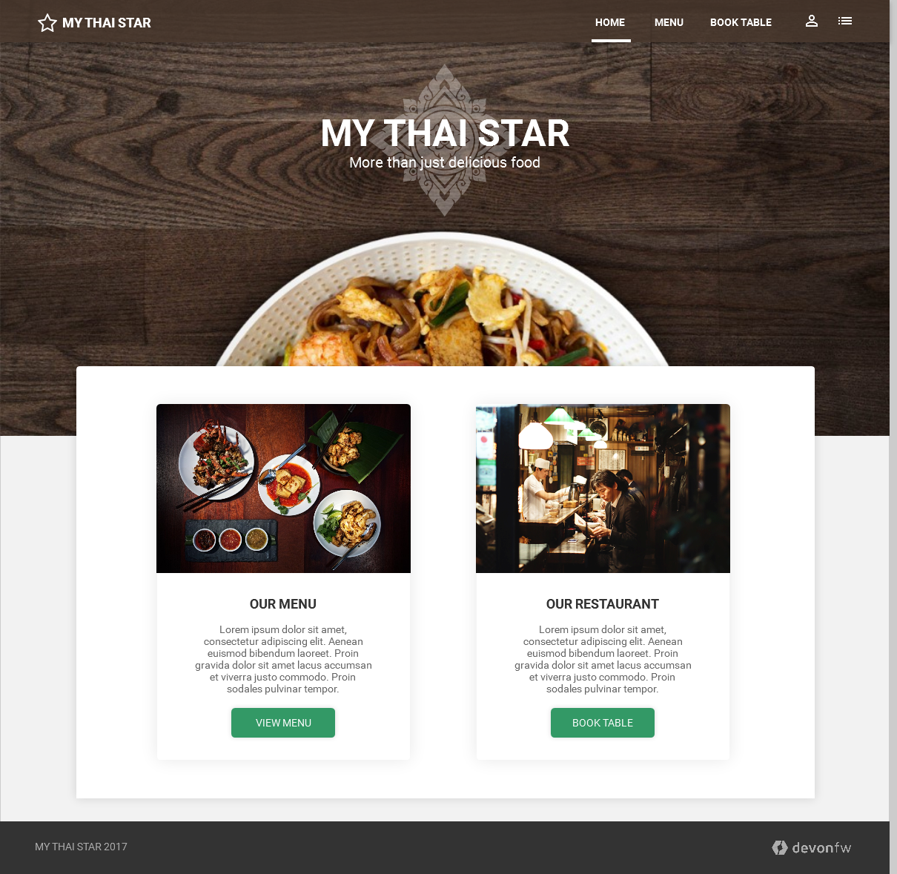
Invite friends: Create invite for friends
Link to book table

Slide 5
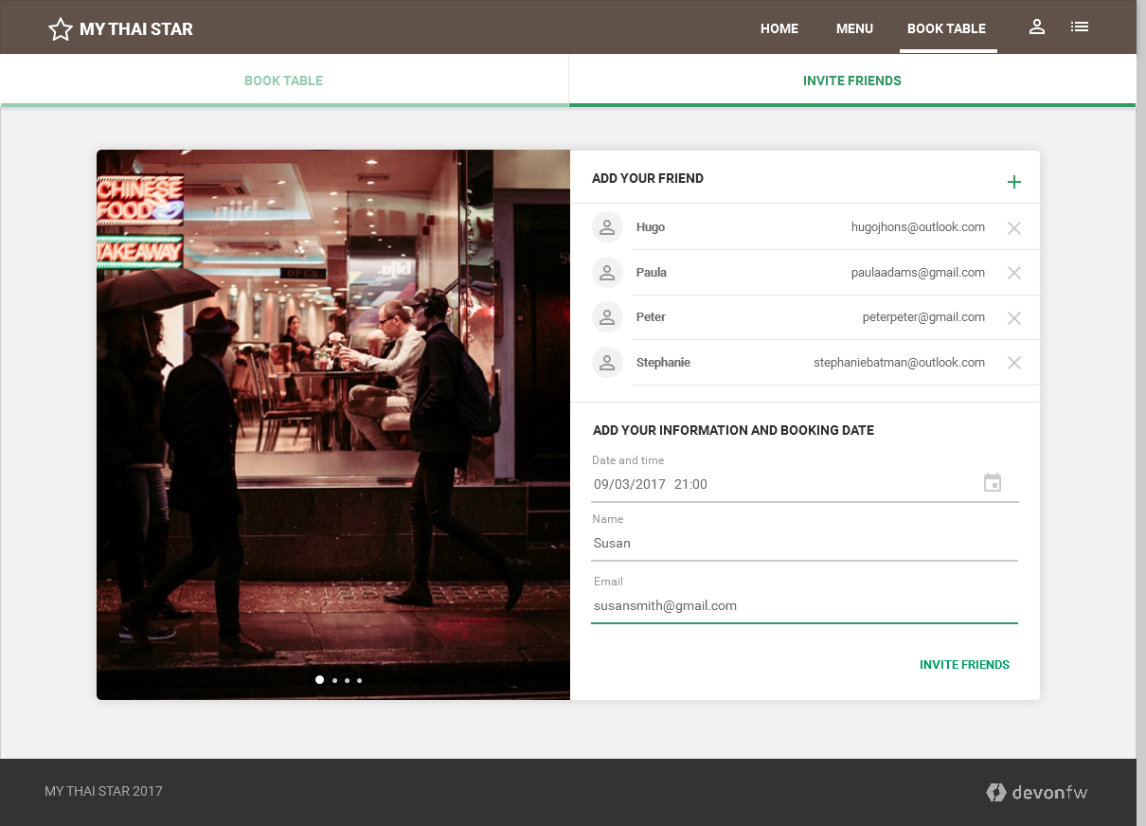
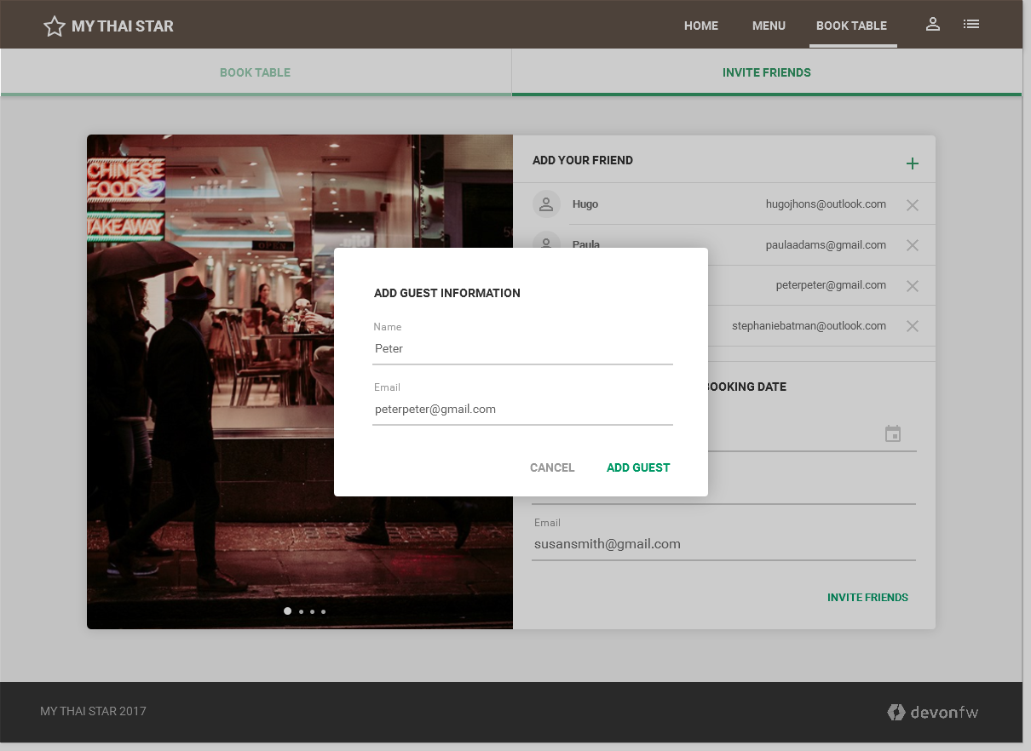
Invite friends: Create invite for friends
Tab navigation for invite friends or book table

Slide 6
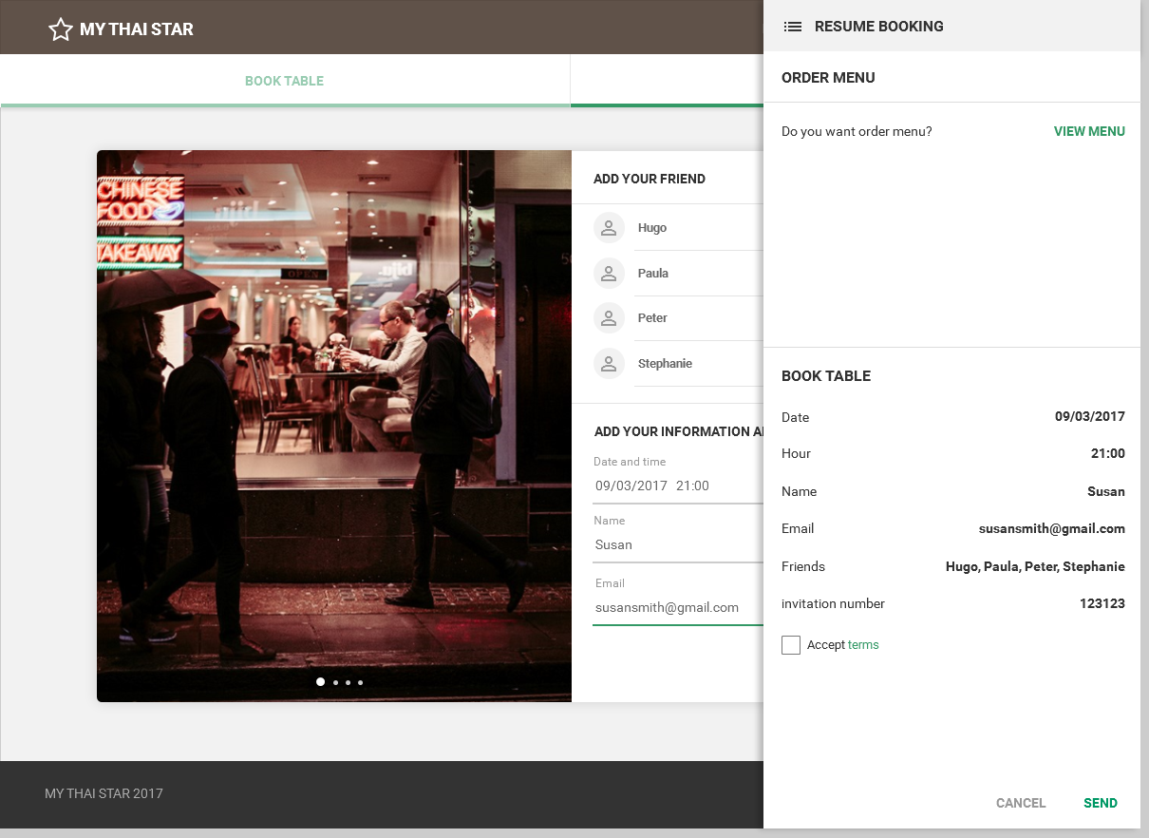
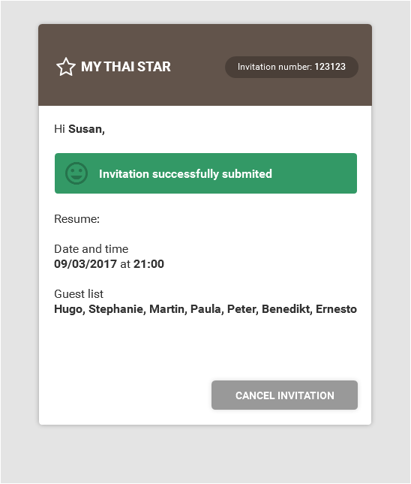
Invite friends: Create invite for friends - Send
Send invitation
Email confirmation

Slide 7
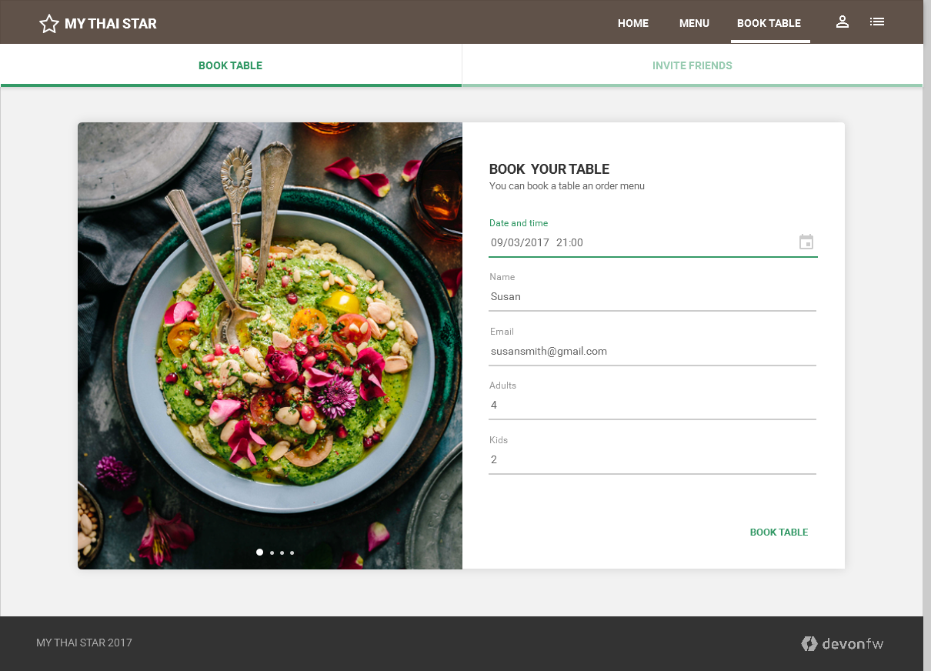
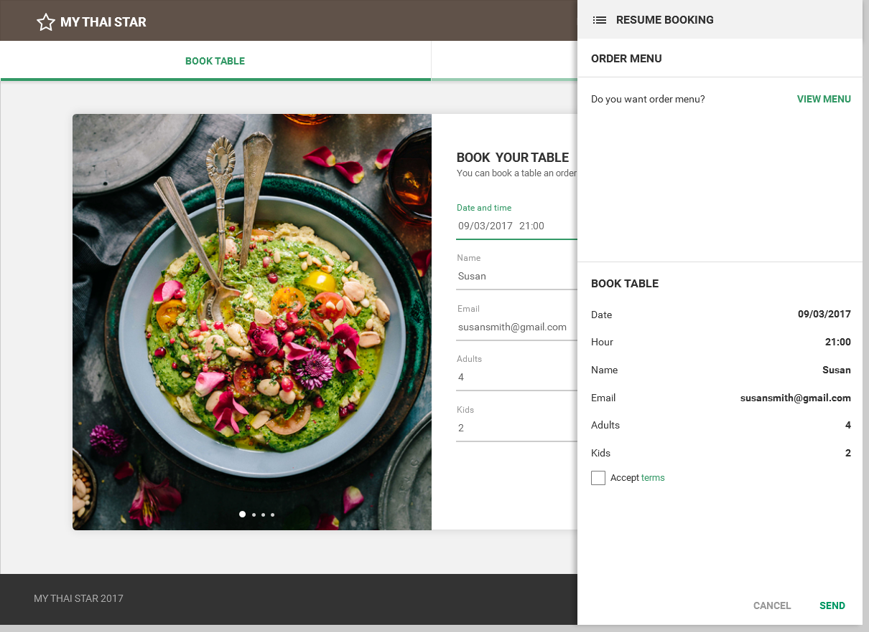
Invite friends: Create reservation and send

Slide 8
Invite friends: Cancel invite
EMAIL NEWSLETTER UI
Confirmation email with cancel invitation option

Slide 9
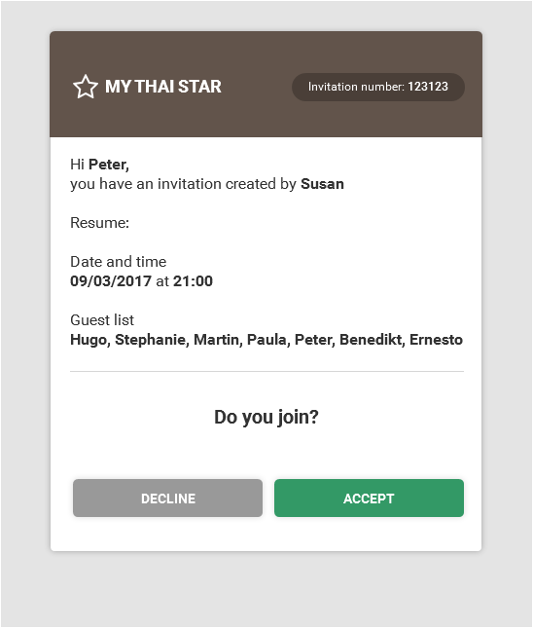
Invite friends: Handle invite
EMAIL NEWSLETTER UI
Email invitation

Slide 10
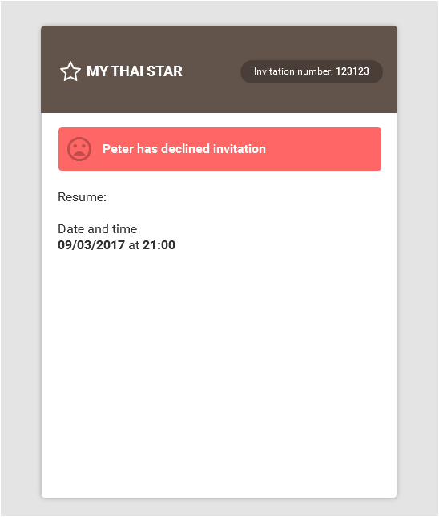
Invite friends: Revoke accepted invite
EMAIL NEWSLETTER UI
Email decline invitation

Slide 11
Digital menu
MY THAI STAR

Slide 12
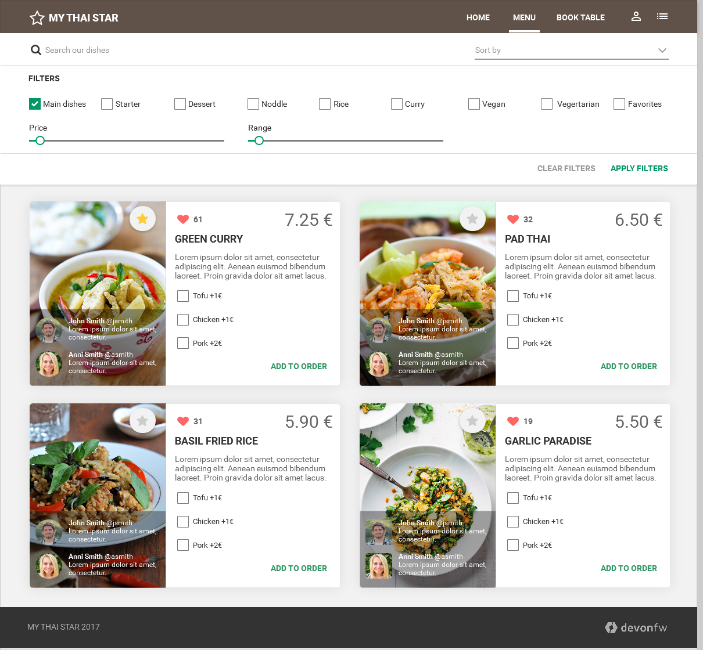
Digital menu: Filter menu
MENU UI
Filters

Slide 13
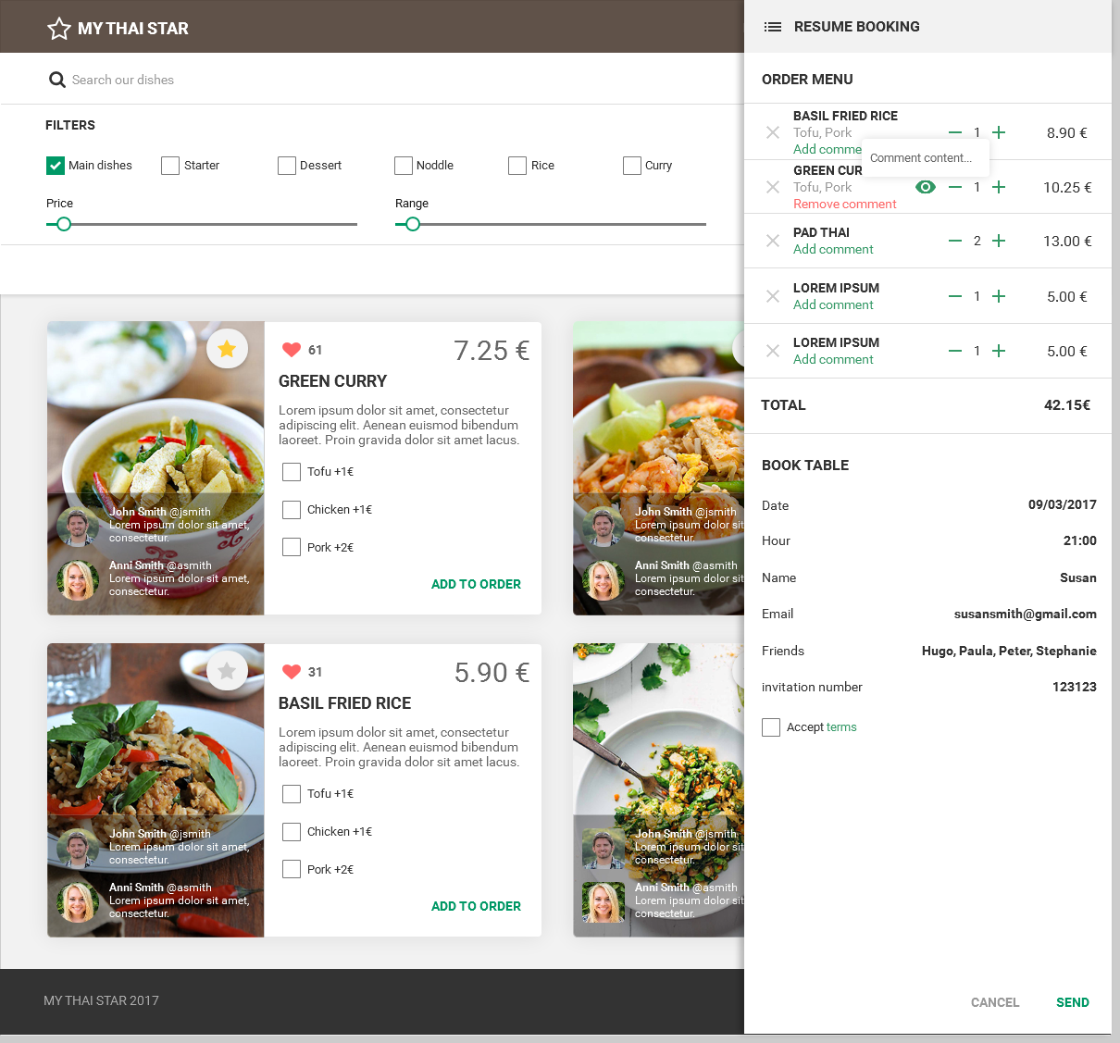
Digital menu: Define order
MENU UI
Select dishes

Slide 14
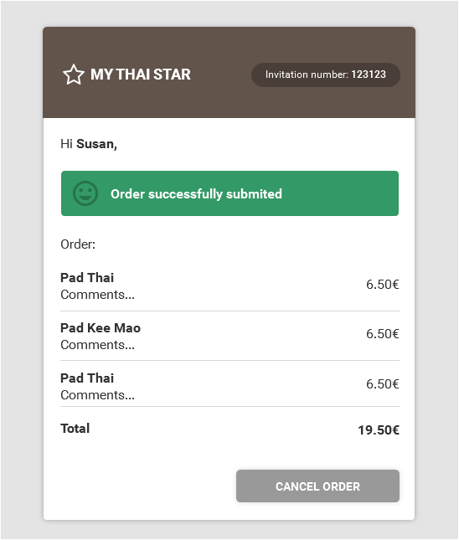
Digital menu: Order the order
MENU UI ORDER THE ORDER
Send order
EMAIL NEWSLETTER UI
Order confirmation

Slide 15
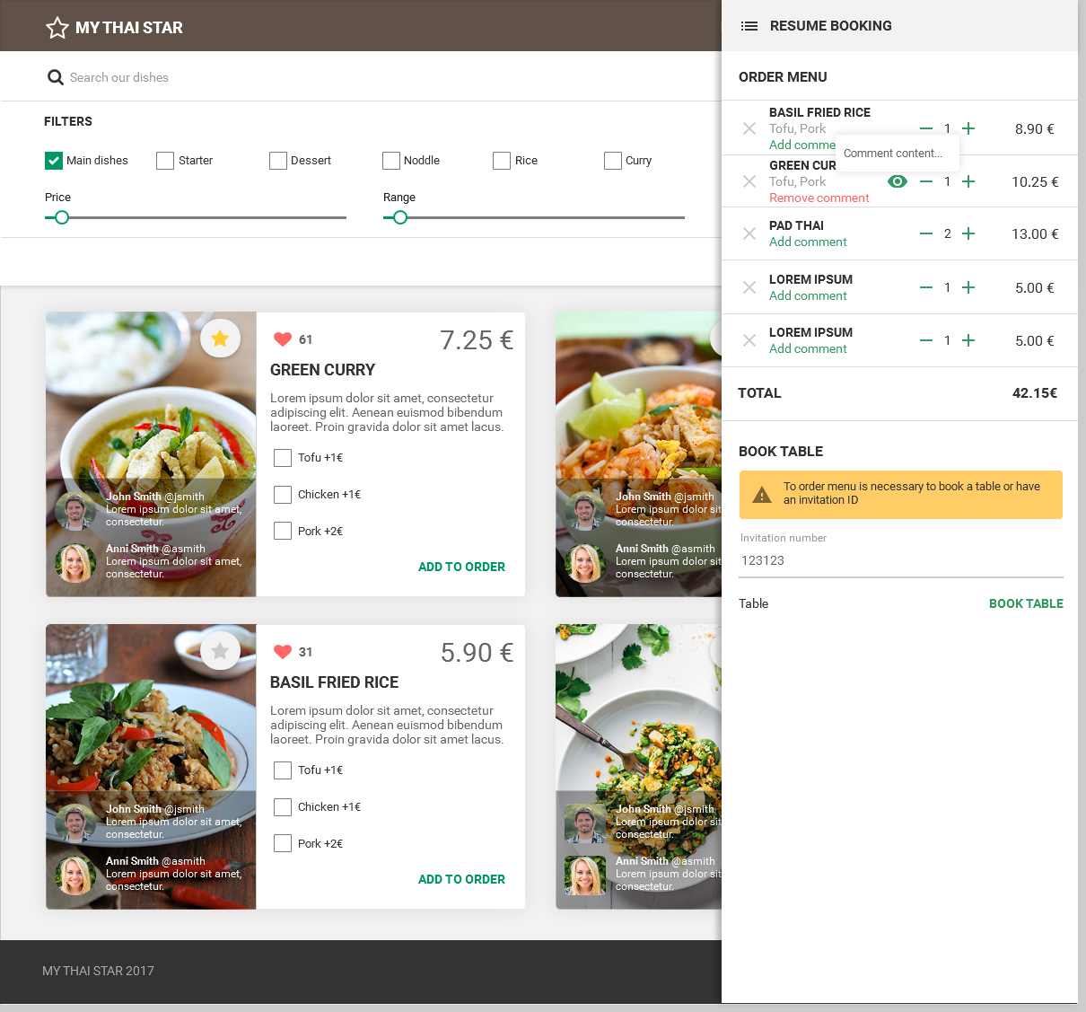
Digital menu: Order the order - precondition for ordering
MENU UI ORDER THE ORDER
precondition for ordering
You need book a table or introduce an invitatio ID to order menu.

